Slide 1
IMM 120 / CSC 101
Welcome!

Slide 2
0. About the Class

Slide 3
My Name is Chris Hallberg
crhallberg@gmail.com
Office: Top of the stairs, right, end of the hall
Office Hours: 10am until class every Monday

Slide 4
About the Class
There is no textbook for the class
Make: Getting Started with p5.js
by Lauren McCarthy (creator of p5.js)
JavaScript: The Good Parts
by Douglas Crockford
The Nature of Code
by Daniel Shiffman (online)

Slide 5
About the Class
Important Links
GitHub: https://github.com/crhallberg/IMM120
Codepen: https://cdpn.io/e/ZyrdYG

Slide 6
About the Class
There are 13 classes in this semester and a final lab
Right now, 9 of them are instructional
2 are time for the midterm
2 are time for the final project

Slide 7
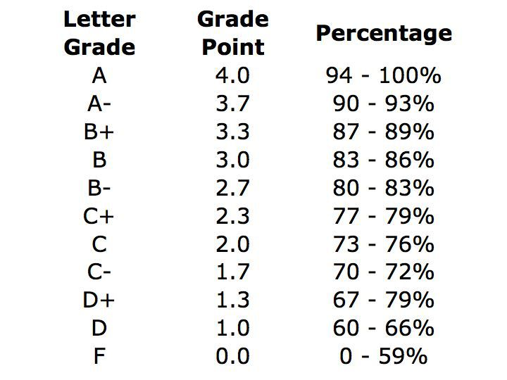
About the Class
Your final grade will consist of*:
15% for attendance
25% of all Homework
25% for your midterm project
35% for your final project

Slide 8
About the Class
Your final grade will consist of * :
15% for attendance
25% of all Homework
25% for your midterm project
35% for your final project

Slide 9
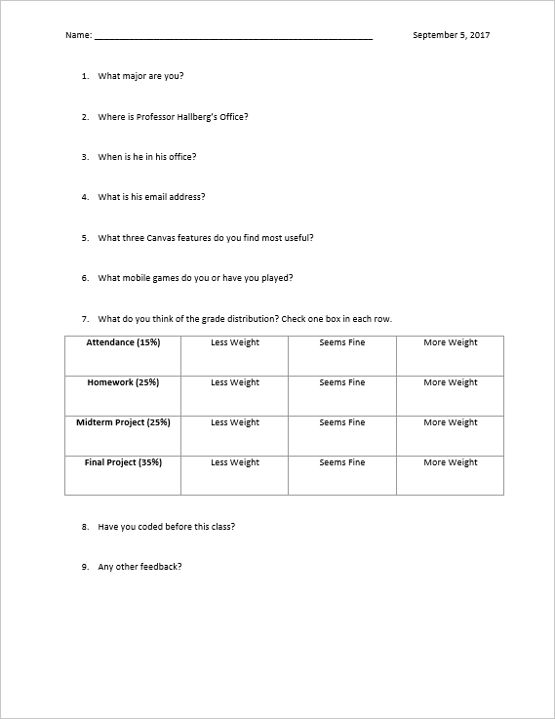
Minute Surveys

Slide 10
1. Learning to Program
"All programmers are playwrights and all computers are terrible actors.“
~ Anonymous

Slide 11
What it’s like to learn to program
Like learning a foreign language
Like learning a new way to think (algorithmically)
Learning a formal way of breaking down problems into steps

Slide 12
Programming is a Skill
It can be learned and it can be difficult

Slide 13
For example: Doors
Can the player open them?
Can the player open every door in the game? Or are some doors for decoration? How does the player know the difference? Can doors be locked and unlocked?
What tells a player a door is locked and will open, as opposed to a door that they will never open?
Does a player know how to unlock a door? Do they need a key? To hack a console? To solve a puzzle? To wait until a story moment passes?
Where do enemies come from? Do they run in from doors? Do those doors lock afterwards? Are there doors that can open but the player can never enter them?
How does the player open a door? Do they just walk up to it and it slides open? Does it swing open? Does the player have to press a button to open it? Do doors lock behind the player?
What size is a door? Does it have to be big enough for a player to get through?
What about co-op players? What if player 1 is standing in the doorway – does that block player 2?
What about allies following you? How many of them need to get through the door without getting stuck?
What about large enemies? Do enemies that are larger than a person also need to fit through the door?

Slide 14
For example: Sandwiches
This is going to be silly
Does anyone have a peanut allergy?

Slide 15
2. p5.js and Codepen
How we’re going to learn how to program

Slide 16
https://cdpn.io/e/ZyrdYG p5.js coding template

Slide 17
Homework
Take your house and email me the link and the exported zip of your project.
crhallberg@gmail.com

Slide 18
Minute Surveys
Once you hand in your survey, you may go.
If you have questions or concerns, I will stay and answer them for as long as I can.

